Slide 1
Classify the finance social median users as human or bots using supervised-machine learning
Supervisors: Prof. Sai Ping LI & Prof. Rui ZHANG
Student: Li Chaoyi

Slide 2
Paper reading
Social media bots and stock markets
Dataset：Twitter
287579412.pdf (core.ac.uk)
Use the manually defined standard to classify human and bots.
at least five tweets during abnormal tweeting times, that is, from 0:00 to 6:00 a.m.;
more than 10 tweets are posted a day
(c) repeating the same tweet content three times or more on one day.

Slide 3
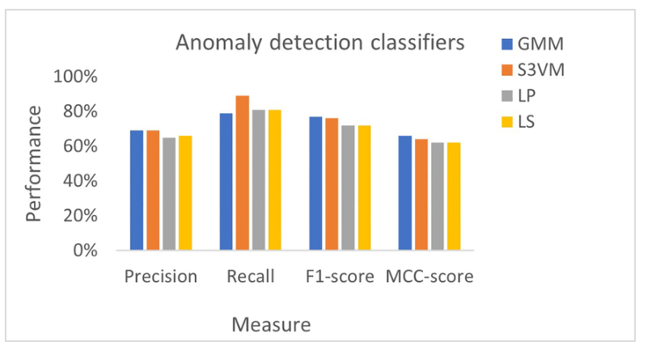
Paper reading
Classifying social media bots as malicious or benign using semi-supervised machine learning
Dataset：Twitter
https://doi.org/10.1093/cybsec/tyac015
identifying meaningful features indicative of anomalous behavior between benign and malicious bots and applied four semi-surpervied method in twitter to compare them.
Benford’ s law
not require any parameter fitting
Can perform well for the lack of proportion in data sizes
Four semi-surpervised method:
Semi-supervised Gaussian mixture model
Semi-supervised SVM
Semi-supervised label propagation
Semi-supervised label spreading

Slide 4
Research plan
Use Benford’s law (BL) to select feature in the Guba dataset
Applied SVM on the dataset to classify social bots or human

Slide 5
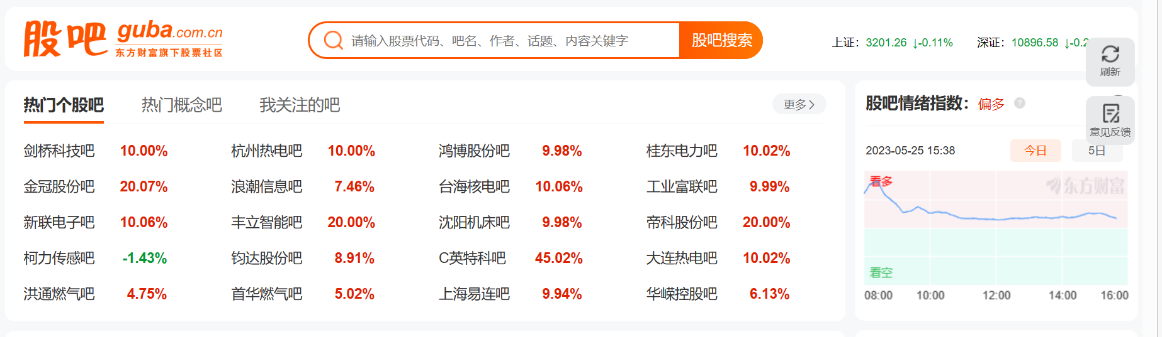
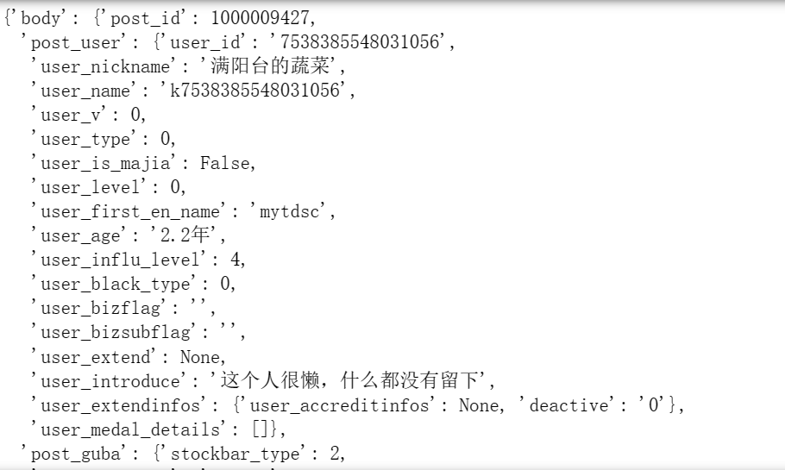
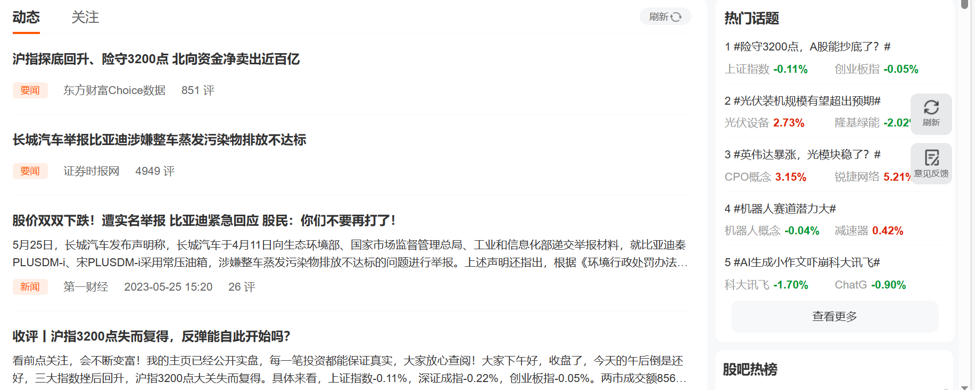
Dataset

Slide 6
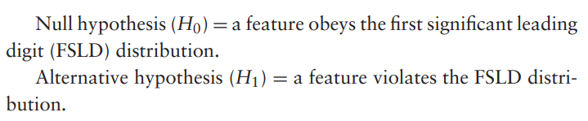

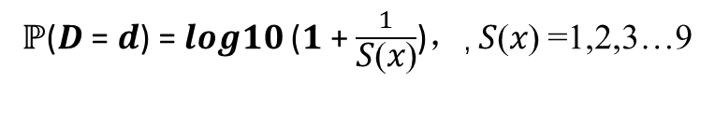
Feature select
Benford’ s law
the First significant leading digit (FSLD)
How to judge a feature is only significant?
if it obeys BL on the bot dataset and simultaneously violates BL on the human dataset.
If a feature violates or does not violate BL on both datasets, then that feature is not deemed significant
positive real number 𝑥
𝑥 = 𝑆(𝑥) ∗ ${10}^{k}$
ℙ(𝑫 = 𝒅) = 𝒍𝒐𝒈𝟏𝟎 (𝟏 + $\frac{1}{\text{S}\text{(}\text{x}\text{)}}$)，, 𝑆(𝑥) =1,2,3…9
If P-value < 0.05, we reject H0; otherwise, we cannot reject H0.

Slide 7
Feature select
user_post_count : the number of user’s post
user_age: the account age of the user
user_v:the user’s VIP level
user_level:the user’s level
user_influ_level: influence of user
user_black_type
post_click_count: number of the user’s post be click
post_comment_count: number of the user’s post be comment
post_forward_count: number of the user’s post be forward
post_like_count: how many people like this post
post_inshare_count: how many people share this post

Slide 8
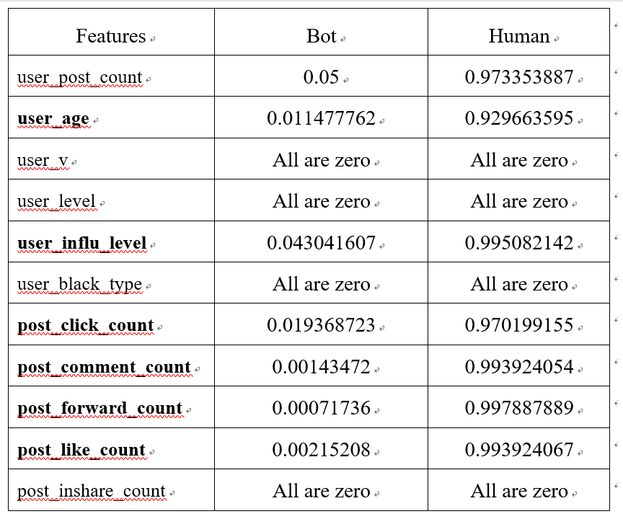
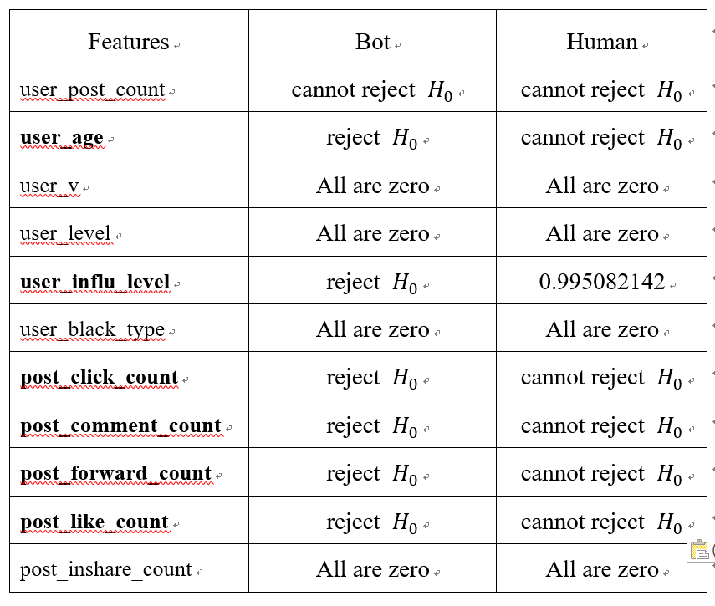
Feature select
Calculate the p-value for very features

Slide 9
Data prepare
ground truth:
Current data :
37156 posts
1394rob 35762human
Data set
Label
1 rob
0 human
Train
1000 rob
35462 human
Test
394 rob
300 human
Robs post from 0:00 to 6:00 a.m
more than 10 post are posted a day
(c) repeating the same post content three times or more on one day.

Slide 10

Classify experiment
$$Accuracy=\frac{TP+TN}{TP+TN+FP+FN}$$
Acc: 80.1%

Slide 11
Prediction
128 different (classify for every post)
3 rob
125 human

Slide 12
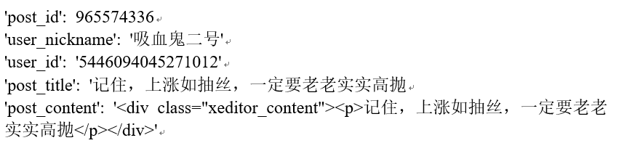
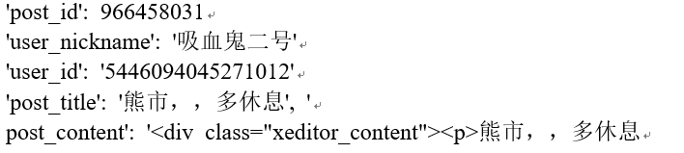
Rob
Rob1
Rob2

Slide 13
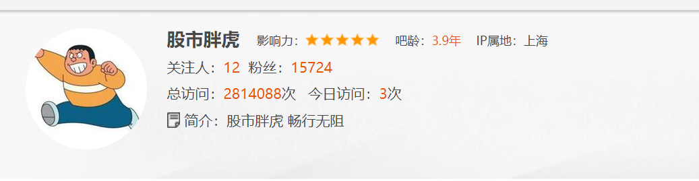
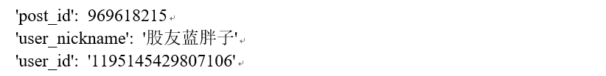
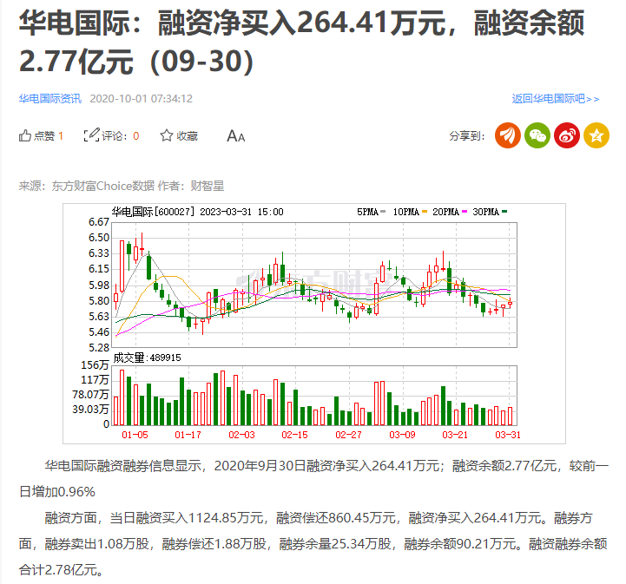
Rob
Rob3
post_content:

Slide 14

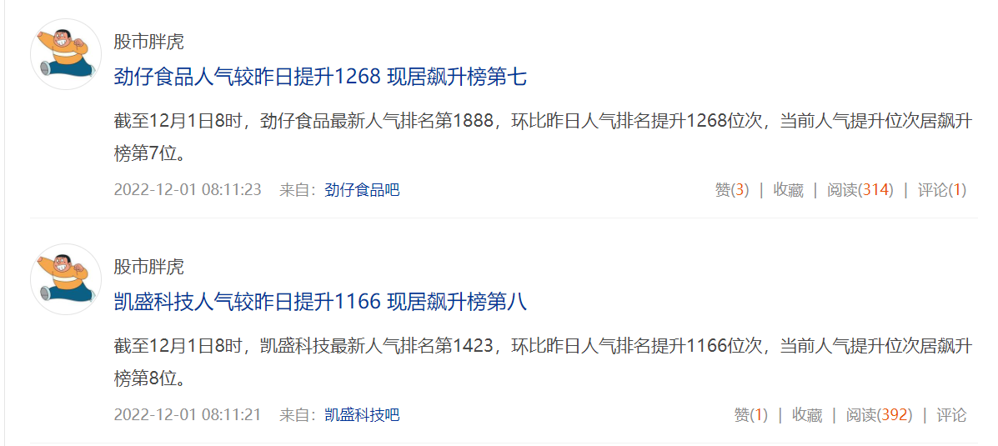
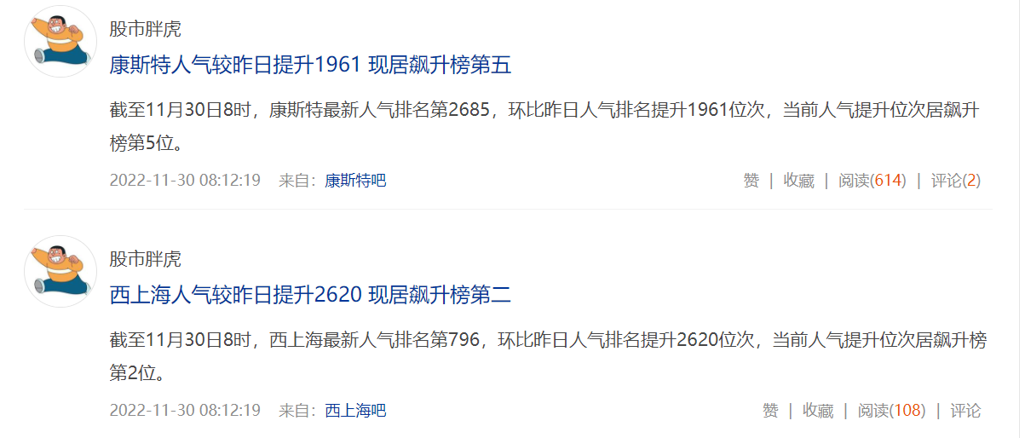
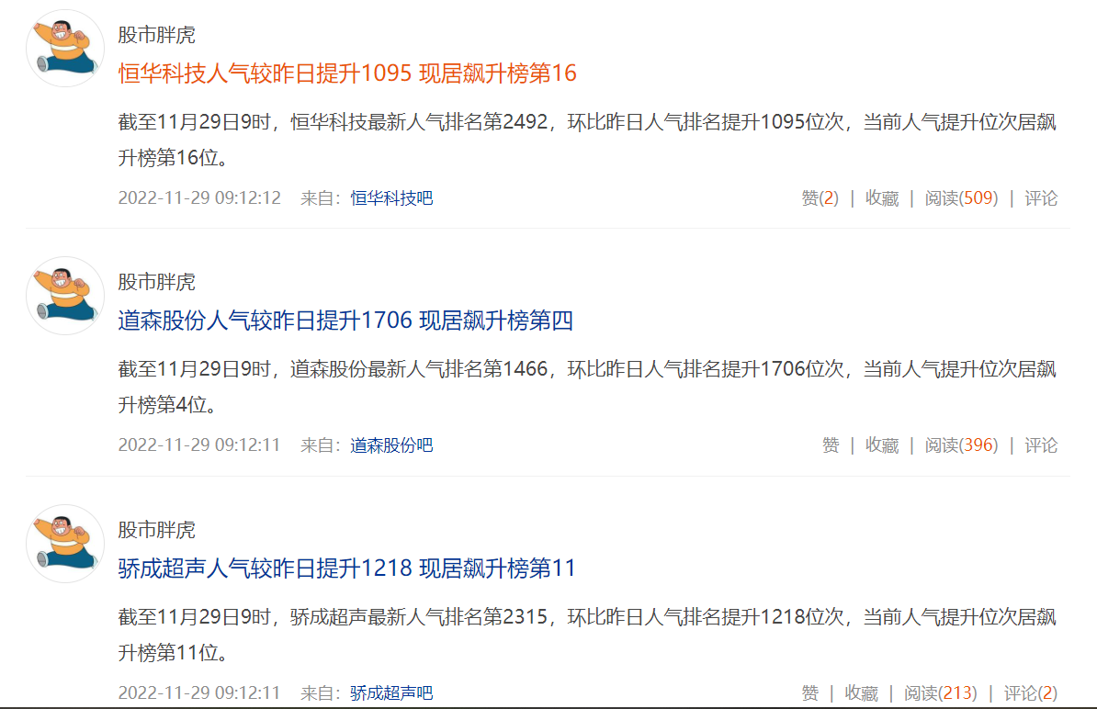
Rob
Rob3
Home page : https://i.eastmoney.com/4538375599889724

Slide 15
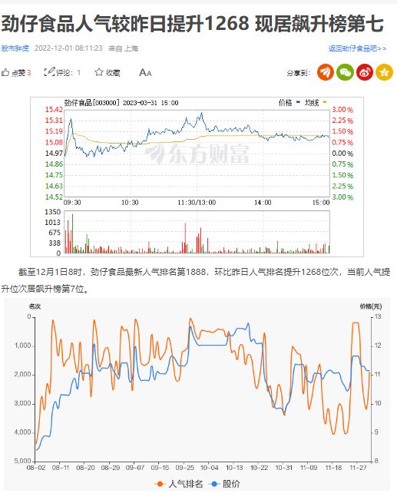
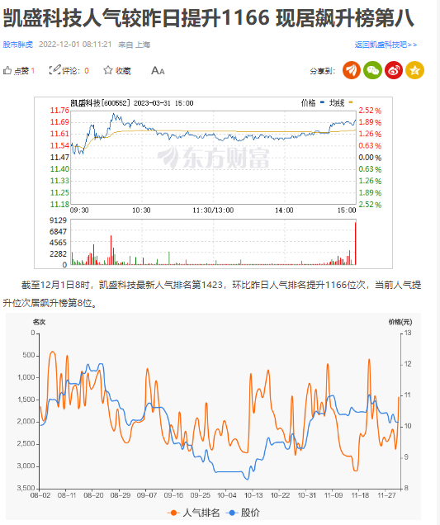
Rob
Rob3
劲仔：http://guba.eastmoney.com/news,003000,1253304644.html
凯盛：http://guba.eastmoney.com/news,600552,1253304638.html

Slide 16
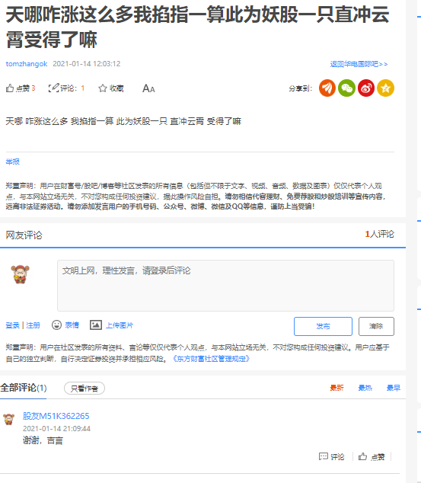
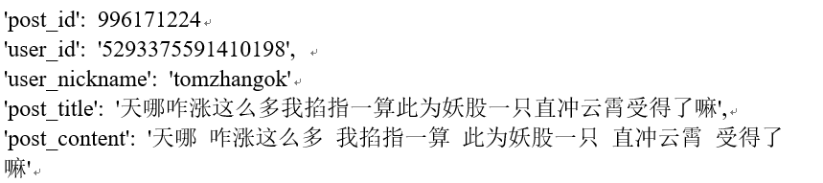

Human
human1
Home page
https://i.eastmoney.com/5293375591410198#guba
Post url
http://guba.eastmoney.com/news,600027,996171224.html

Slide 17
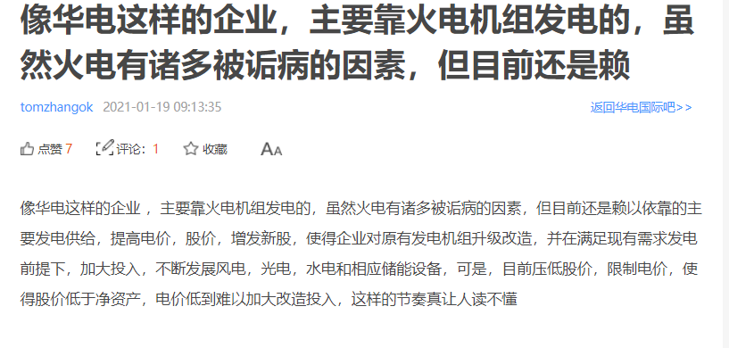
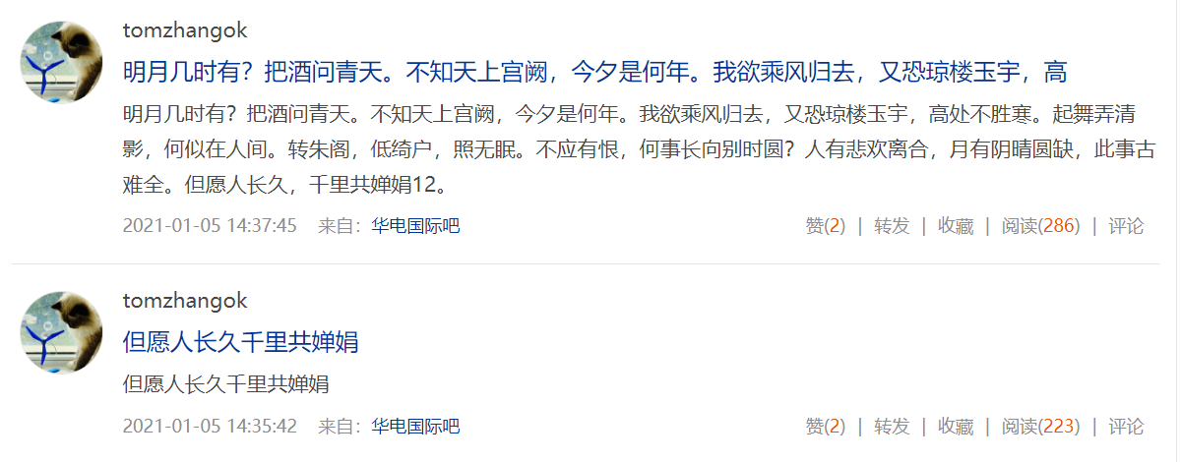
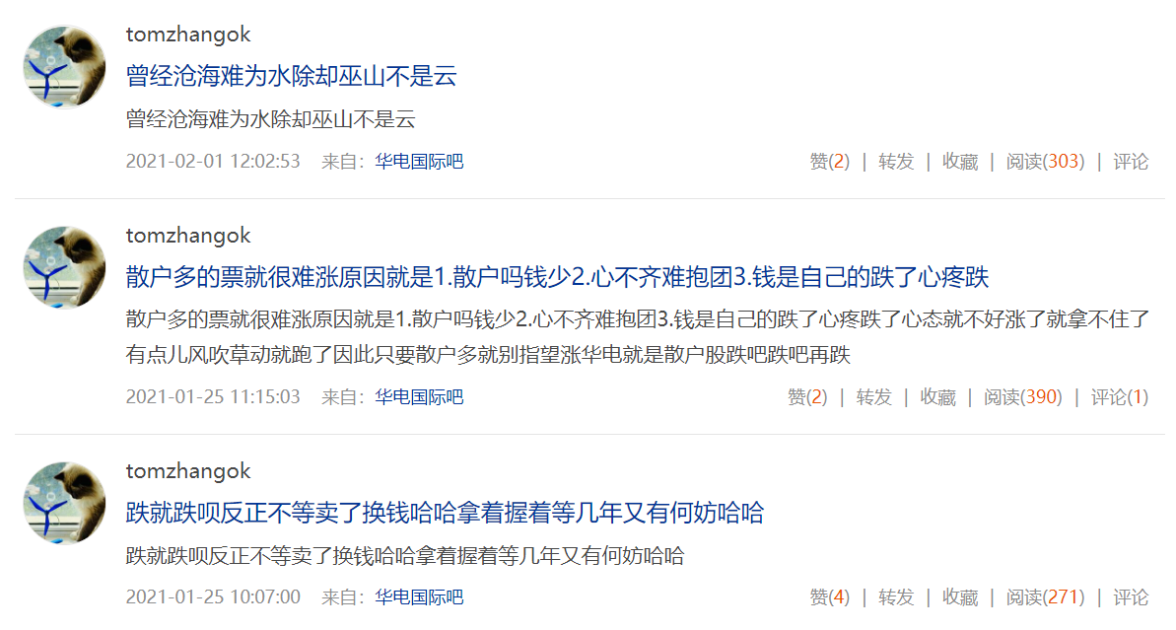
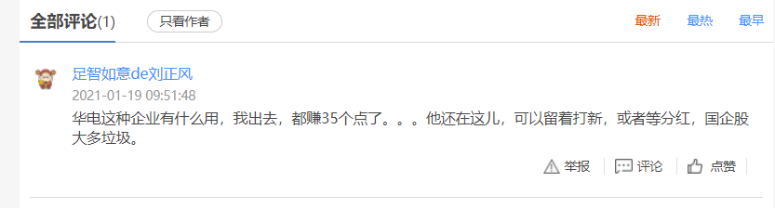
Human
human1
Home page
Home page
Post url
https://i.eastmoney.com/5293375591410198#guba
http://guba.eastmoney.com/news,600027,997361490.html

Slide 18


Human
human2
Home page
Home page
https://i.eastmoney.com/6457094382485162

Slide 19
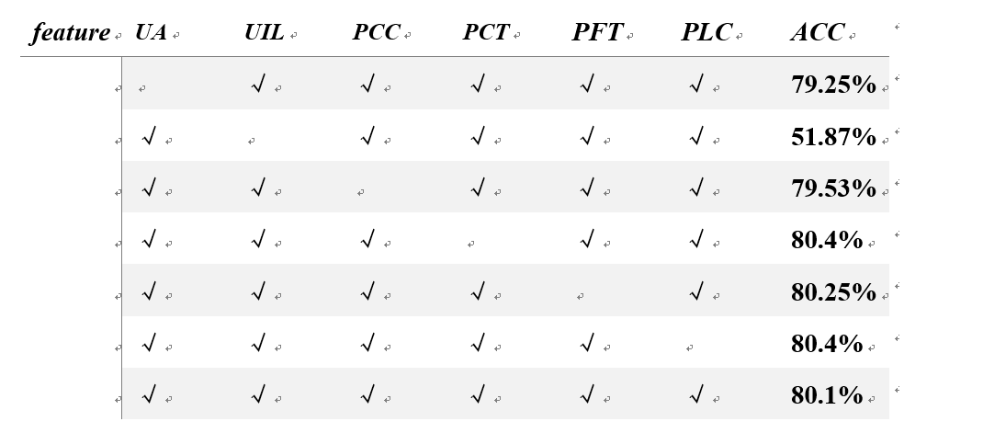
Ablation experience
UA:user_age UIL:user_influ_level PCC: post_click_count PCT:post_comment_count PFT: post_forward_count PLC:post_like_count ACC:accuracy

Slide 20
Conclusion
Feature select
UA:user_age
UIL:user_influ_level
PCC:post_click_count
PCT:post_comment_count
PFT: post_forward_count
PLC:post_like_count
Higher accuracy:
Ground truth exist some error
More enlarge the range of selectable features to do the feature selection

Slide 21
Thank for watching.

